Slide 1
Problem Identification
OBJECTIVES
Financial loss of $1,500,000 due to the expense of maintaining the new chair lift
Lack of proper operational business model based on existing market situation
POSSIBLE TARGETS
Increase admission ticket cost
Decrease the operational cost on some trails (runs)

Slide 2
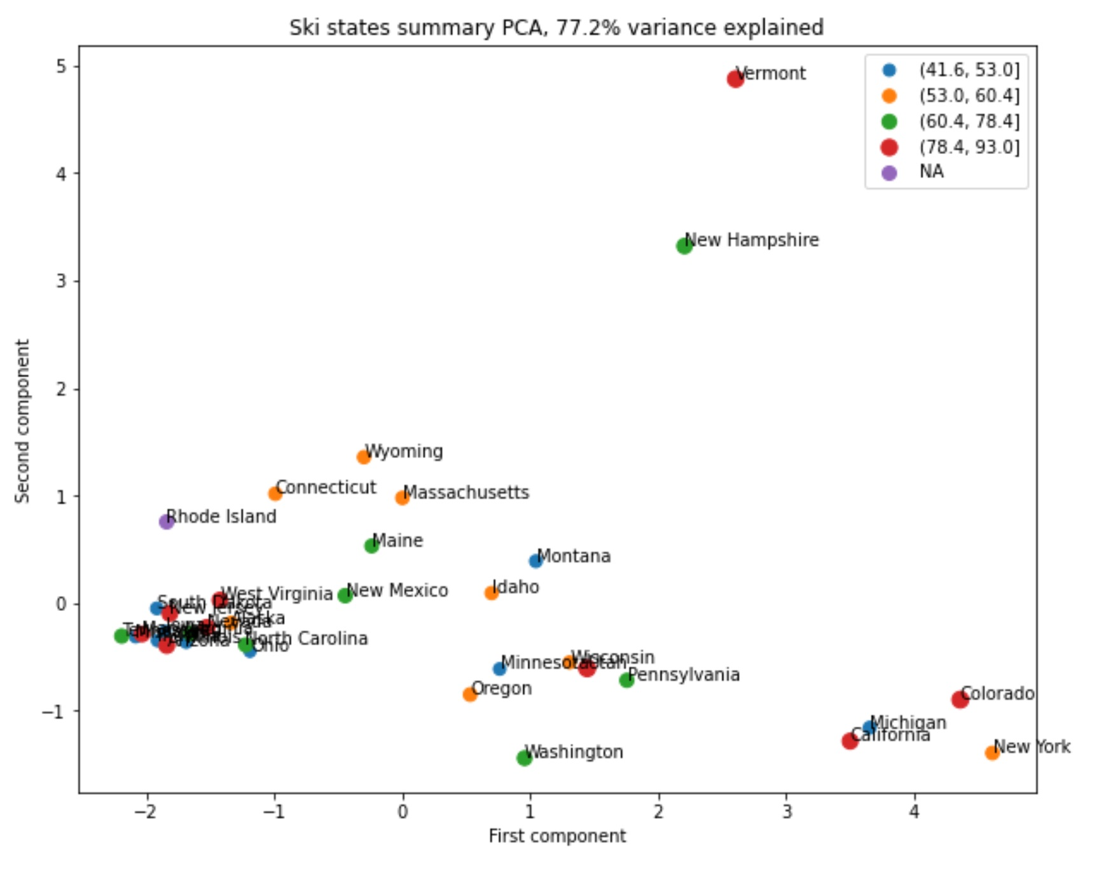
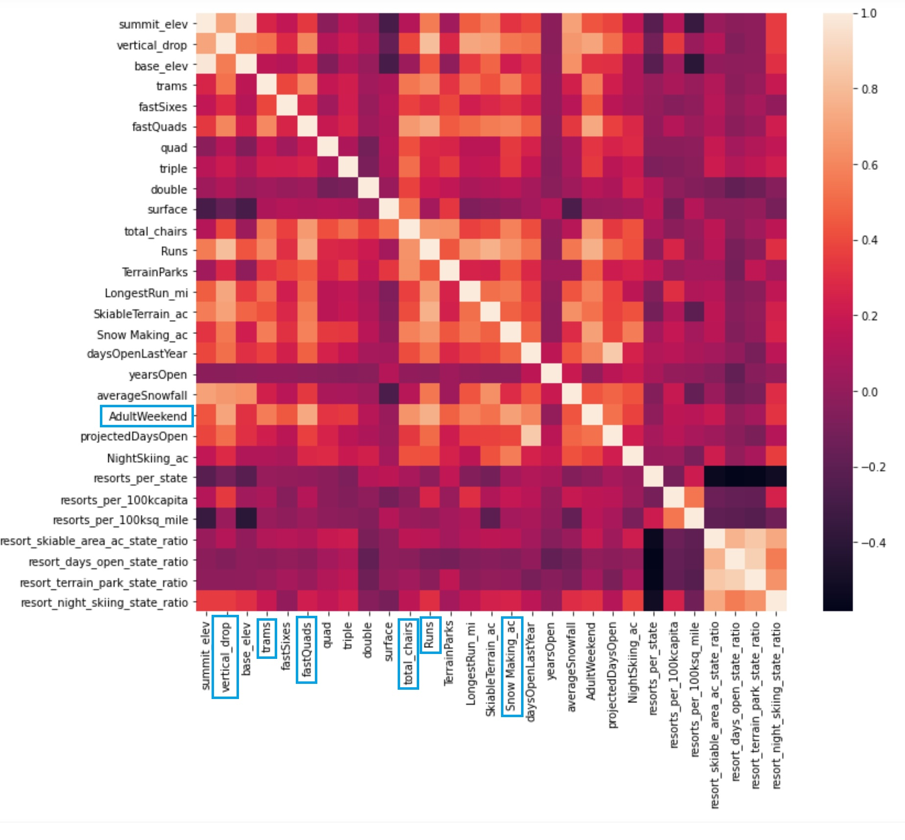
Recommendation and key findings
No clear relationship between state and ticket
Some valuable correlation among features

Slide 3
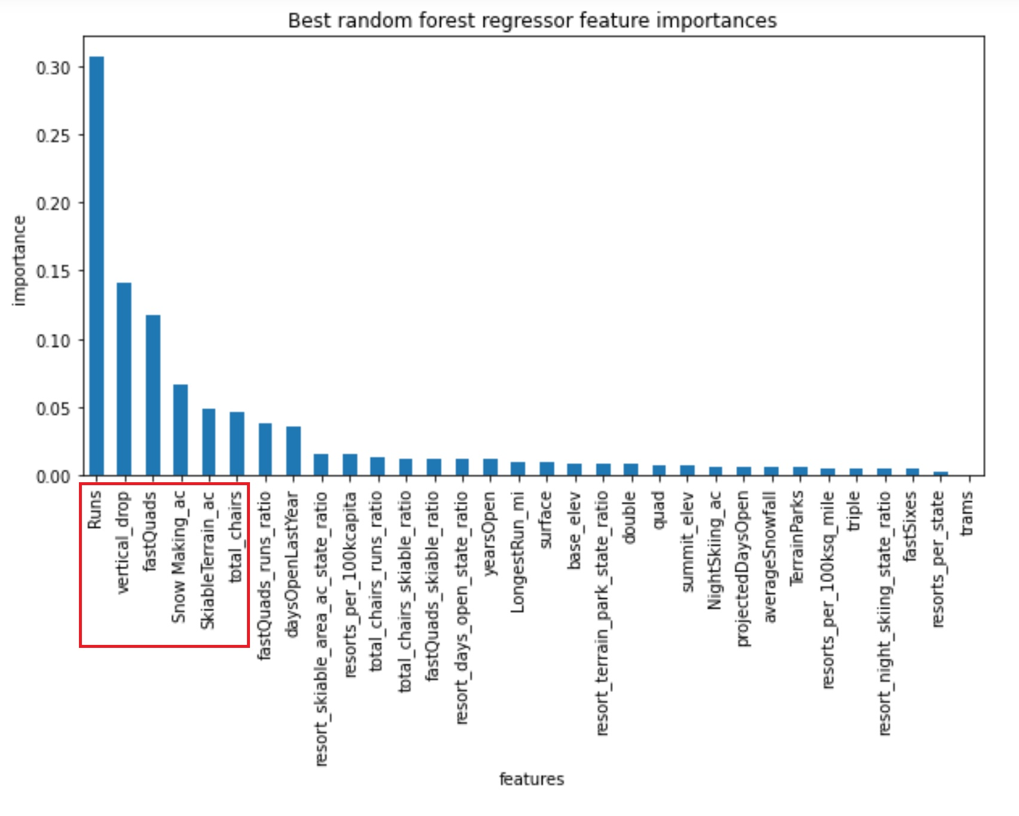
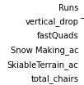
Modeling results and analysis
Model we used for this task was “The Random Forest”
Main correlations among the existing features

Slide 4
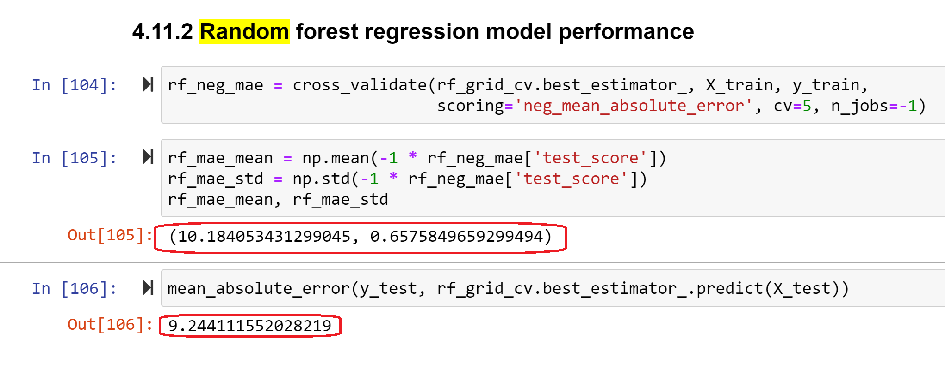
Modeling results and analysis
The Random Forest model has lowest cross-validation mean absolute error
It produces less variability

Slide 5
Conclusion
Model works based on the idea that most resorts set their prices according to market support
Currently, company undercharging for the admission by $5-$10 (within mean absolute error)
Adding new chair lift in the future will not increase the annual revenue (most likely it will decrease it significantly)
Investing in vertical drop will bring increase by $2 on average
Dropping operational cost on a few runs (3 of them) will save some money

